Slide 1
Learning Reflection Platform
Presentation 3
Modules Update
Presented By
Amita Kumari EN23CS301121
Anaaya Bhattacharya EN23CS301123
Anjali Gour EN23CS301136
Guided By
Prof. Deepika Saraswat
Prof. Jyotsana Goyal

Slide 2
Working of Metadata Extraction Module
The Metadata Extraction Module is designed to automatically retrieve essential information from a user-provided learning resource link. The process begins at the frontend, where the user enters a URL and initiates the extraction request.
This request is handled using JavaScript, which sends the link to the backend through a POST request. On the server side, the PHP script processes the request by fetching the HTML content of the given webpage. The retrieved HTML is then parsed using a DOM-based approach to identify relevant metadata elements.
The system primarily looks for Open Graph meta tags such as title, description, and site name, which are commonly used by modern websites to describe their content. In cases where Open Graph data is not available, the system attempts to extract fallback metadata such as the standard meta description.
Once the relevant information is collected, it is structured into a JSON response and sent back to the frontend, where it is dynamically displayed to the user in a structured preview format.

Slide 3
Handling Missing or Unavailable Metadata
In practical scenarios, not all websites provide complete or structured metadata. The module is designed to handle such cases gracefully to ensure system stability and usability.
If the webpage does not contain Open Graph tags or standard metadata fields, the extracted values may remain empty. In such situations, the system does not fail abruptly; instead, it returns whatever partial data is available. If no meaningful data can be retrieved at all, an error response is generated, indicating that metadata extraction was unsuccessful.
Additionally, if the system is unable to access the webpage—due to invalid URLs, network restrictions, or unsupported sources—it returns an error message such as “Unable to fetch page.” This ensures that the user is clearly informed about the issue.
This approach maintains robustness by preventing crashes and providing clear feedback, while also highlighting the limitations of metadata availability across different web platforms.

Slide 4
Handling Missing or Unavailable Metadata
The Metadata Extraction Module has been successfully developed and is currently being tested as a standalone component in a local development environment using XAMPP. This setup allows for efficient testing, debugging, and iterative improvements before integration into the main system.
At present, the module demonstrates the core capability of extracting and displaying metadata in a structured format. However, it is not yet integrated with the full Learning Reflection Platform.
In future stages, this module will be incorporated into the Learning Item Management workflow, enabling automatic population of resource details when users add new learning links. The system is also planned to be deployed on a live server environment, along with enhancements such as richer metadata extraction and improved compatibility with dynamic websites.

Slide 5
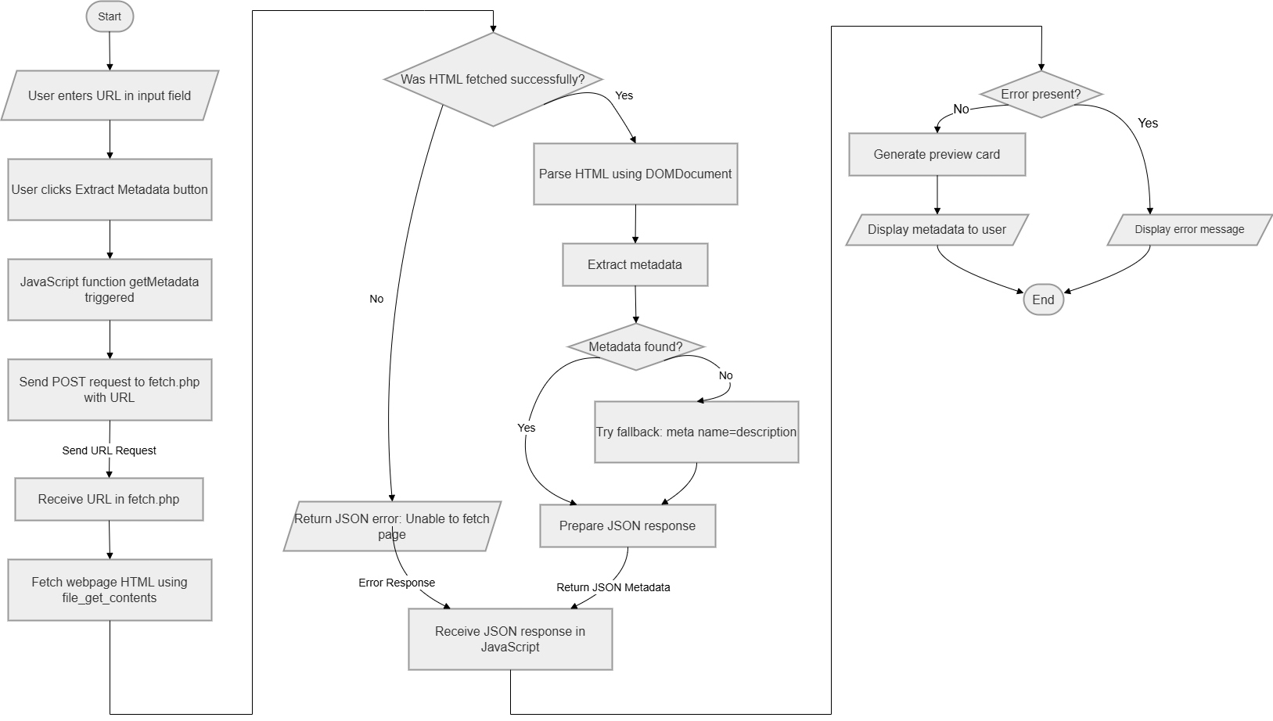
Workflow of Metadata Extraction Module

Slide 6
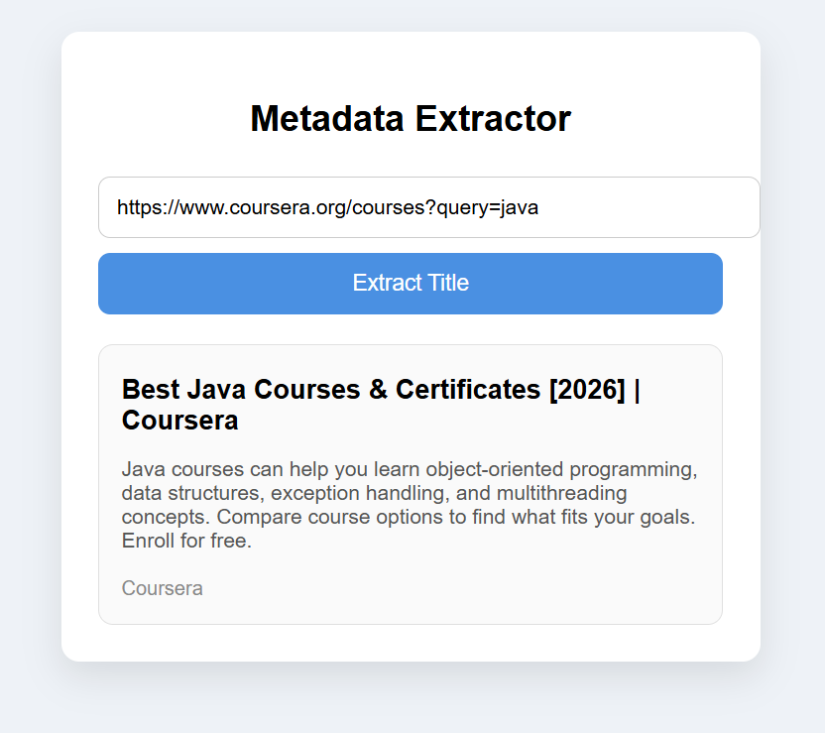
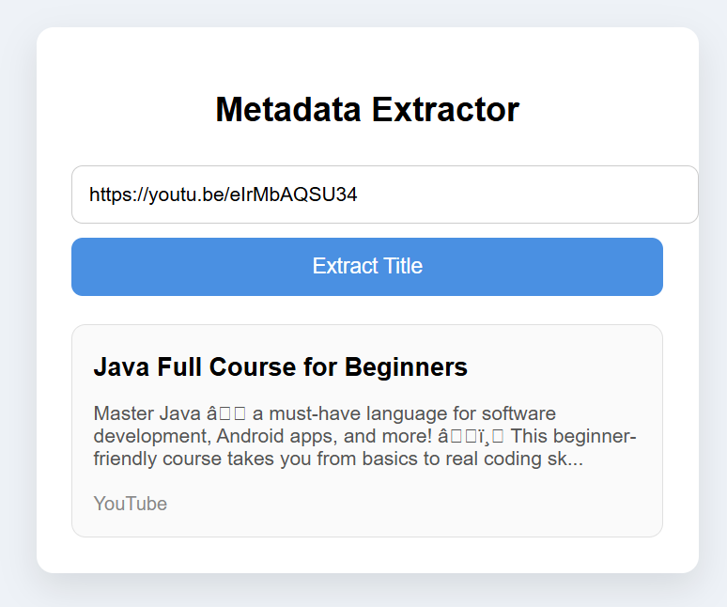
Metadata Extractor in Working

Slide 7
User Authentication System
Overview Provides secure access to the platform Enables user registration and login Restricts access to authorized users only Serves as the entry point to the application Purpose Protect sensitive user data Enable personalized dashboards Support learning progress tracking

Slide 8
Authentication Workflow
Signup Process
User enters name, email, and password
System performs input validation
User data is securely stored
Login Process
User enters credentials
System verifies stored data
On success → redirect to dashboard
Session Handling
Maintains user login state
Prevents unauthorized dashboard access

Slide 9
Current Implementation
Architecture
Client-side authentication model
Modular structure separating UI and logic
Event-driven handling of user actions
Core Components
Input Validation – ensures correct user data
Credential Handling – simulates storage & retrieval
State Management – maintains login session

Slide 10
Future Enhancement
Backend Stack
Node.js + Express
MongoDB Database
Security Improvements
Password hashing using bcrypt
Token-based authentication (JWT)
Secure API validation
Benefits
Supports multiple users
Ensures secure data storage
Provides scalable architecture

Slide 11
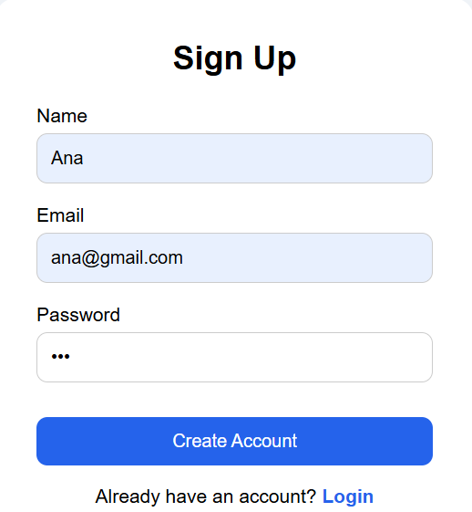
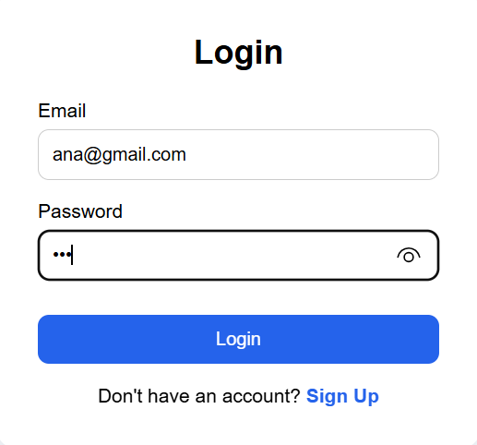
Authentication Module in Working

Slide 12
Notification Module
Overview
• Provides timely alerts for saved learning items
• Notifies users about upcoming and missed deadlines
• Enhances user engagement with the platform
• Ensures users stay consistent with learning tasks
Purpose
• Remind users about pending learning items
• Prevent missing important deadlines
• Improve learning discipline and consistency
• Support effective time management

Slide 13
Notification Workflow
Input Process
• User adds learning item with deadline
• System stores item details
Processing
• System fetches current date
• Compares current date with stored deadline
• Identifies due or overdue items
Output Process
• Generates notification alerts
• Displays notifications on user interface

Slide 14
Current Implementation
Architecture
• Client-side notification system
• Uses JavaScript for logic execution
• Dynamic rendering of notifications
Core Components
• Reminder Storage – stores learning items
• Date Comparison Logic – checks deadlines
• UI Rendering – displays notifications
• Event Handling – triggers on page load

Slide 15
Future Enhancements
Backend Integration
• Use Node.js + Express.js
• Store data in MongoDB
Advanced Features
• Real-time notifications
• Email/SMS alerts
• Push notifications
• AI-based reminder suggestions

Slide 16
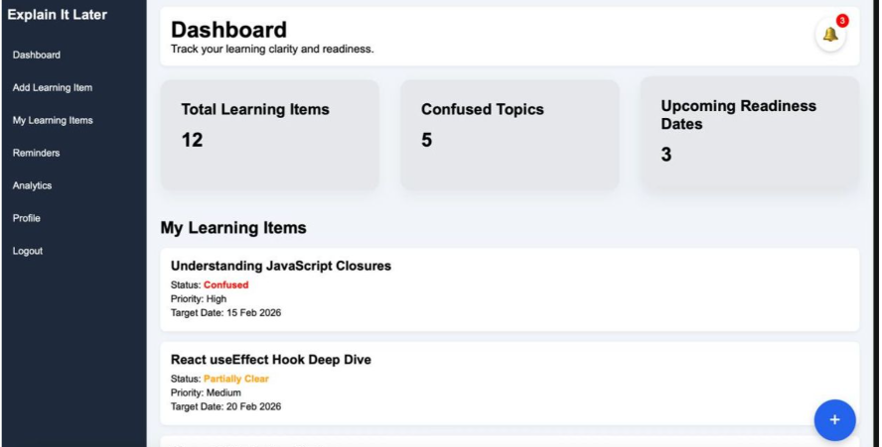
Notification Button

Slide 17
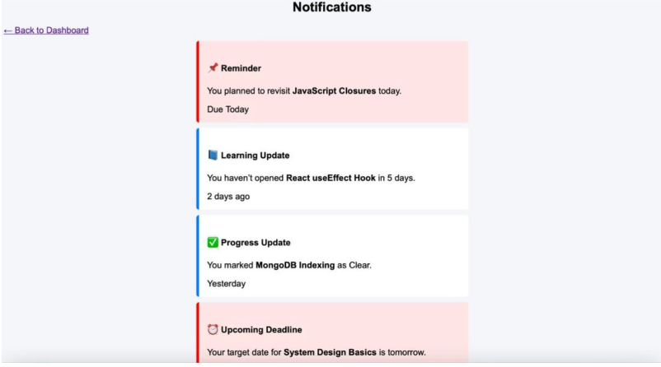
Notification screen

